Slide 1
Cancer Immunotherapy Trial Design
with Long-Term Survivors
Statistical Practice in Cancer Conference
Jianrong Wu
BBSRF
University of Kentucky
Feb 28-29, 2020
(joint work with Xue Ding)

Slide 2
Outline
Traditional survival trial design
Immunotherapy
Challenge for immunotherapy trial design
Trial design with long-term survivors
Simulation
Case Study
Conclusion

Slide 3
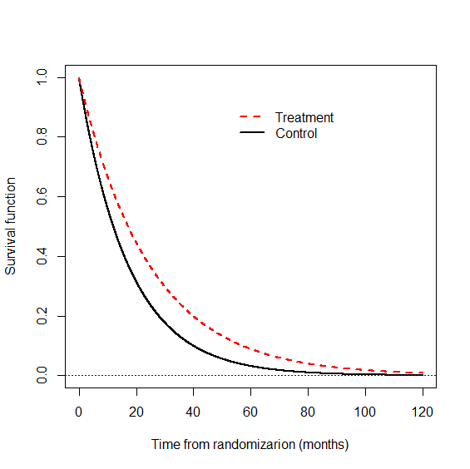

Traditional Survival Model: PHM
Notes:
For traditional survival distribution, all subjects will experience the event with long-term follow-up.
Traditional survival model (PHM) works well for traditional cancer treatment such as Chemotherapy and Chemo+radiation therapy. Treatment is quantified by the Hazard ratio.

Slide 4
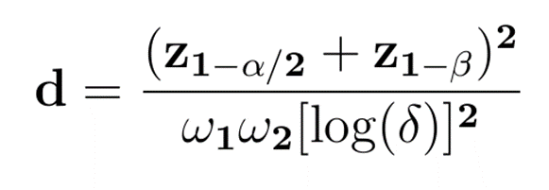
Event-Driven Trial Design
Schoenfeld formula
Sample size : N=d/p
Log-rank test is most powerful test under PH model
Event-driven design is robust against survival, censoring and accrual distributions.
Notes:
Power is determined by number of events instead of sample size.

Slide 5
Immunotherapies
Notes:
Innovative research with immuno-oncology agents advanced the cancer treatment with immunotherapy. The “Big guns” from our immune system to flight cancer are T-cells. However, tumor cell is smart and will bind to T-cells to deactivate the T-cells. Immunotherapy drugs prevent binding tumor cells to T-cells and deactivating T-cells.

Slide 6
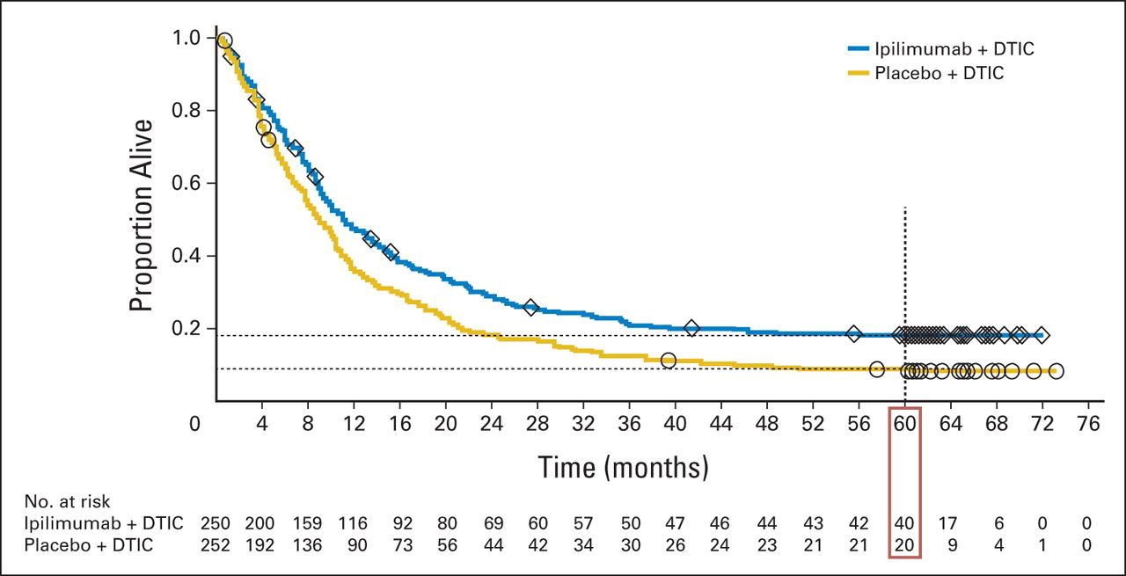
Case Study: Melanoma Trial
Robert et al NEJM 2011; Maio et al JCO 2015
Notes:
This is randomized phase III trial for patients with advanced melanoma. A total 502 patients were randomly assigned 1:1 to receive ipilimumab +dacarbazine or placebo + dacarbazine. The primary endpoint is overall survival. Ipilmumab is a monoclonal antibody which activate the immune-system.

Slide 7
Case Study: Melanoma Trial
Plateau
Robert et al NEJM 2011; Maio et al JCO 2015
Notes:
This is randomized phase III trial for patients with advanced melanoma. A total 502 patients were randomly assigned 1:1 to receive ipilimumab +dacarbazine or placebo + dacarbazine. The primary endpoint is overall survival. Ipilmumab is a monoclonal antibody which activate the immune-system.

Slide 8
Challenge of Immunotherapy Trial Design
Survival distribution function has a plateau. Observed!
Proportional hazards assumption is violated, How?
Single measure hazard ratio may not quantify the treatment effect. What else?
Standard log-rank test is inefficient. Why?
Weighted log-rank test is more efficient with an adequate choice of the weight function.

Slide 9
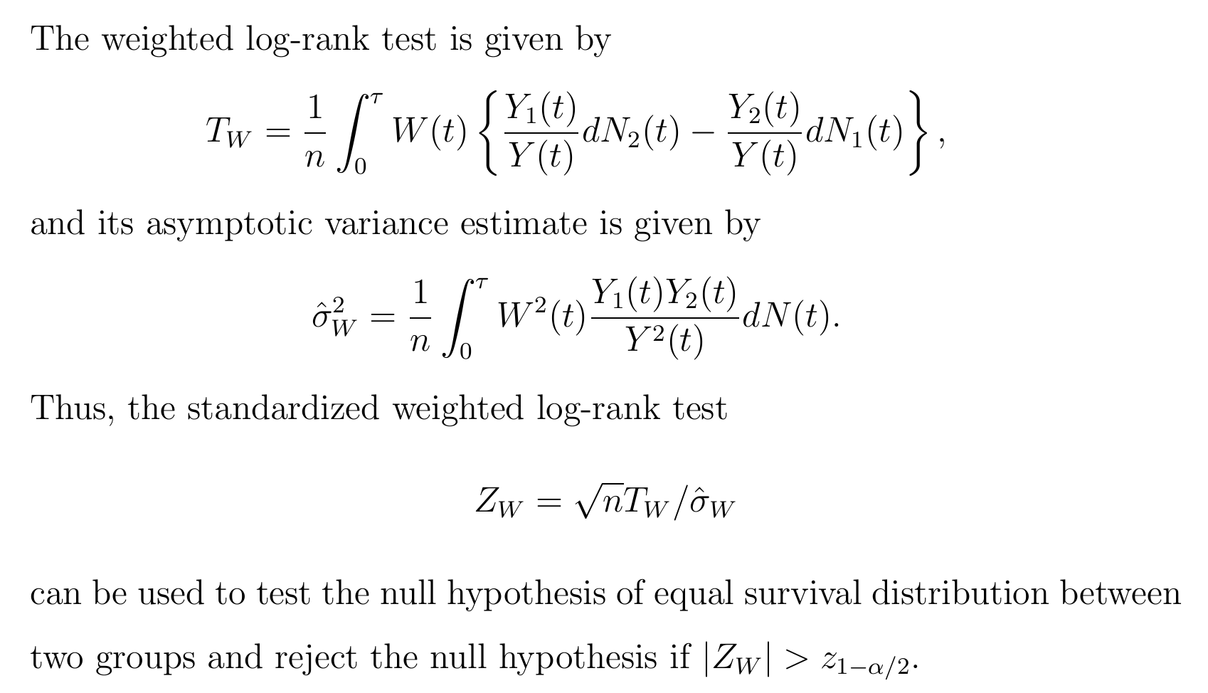
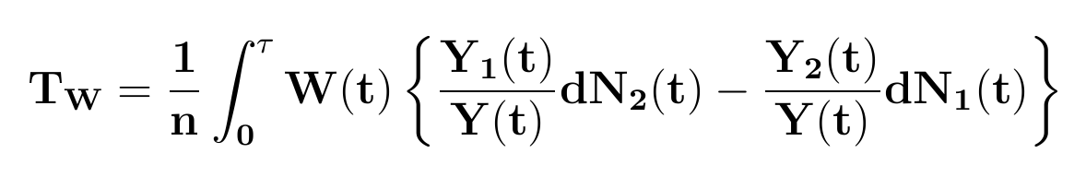
Weighted Log-Rank Test

Slide 10
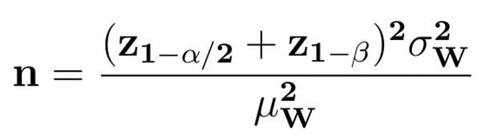
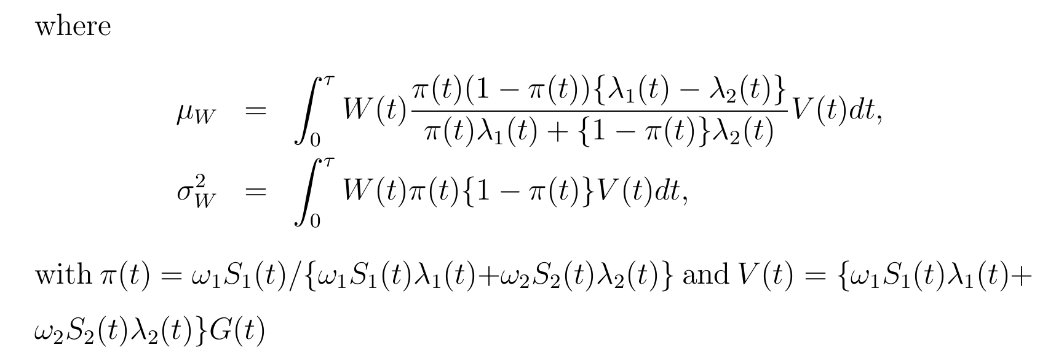
A General Sample Size Formula
Number of events d=np
Notes:
Under Non-PH model, we have to calculate sample size first, then the number of events.

Slide 11
A General Sample Size Formula
Number of events d=np

Slide 12
A General Sample Size Formula
The new sample size formula can be applied to non-PH model as well as PH model.
The new formula provides more accurate sample size estimation under PH model than Schoenfeld’s formula particular for a small hazard ratio (large effect size) and unbalanced design.
The new formula can be applied to any non-PH model, e.g., delayed treatment effect model, long-term survival model, crossing hazards model, with an appropriate weight function.

Slide 13
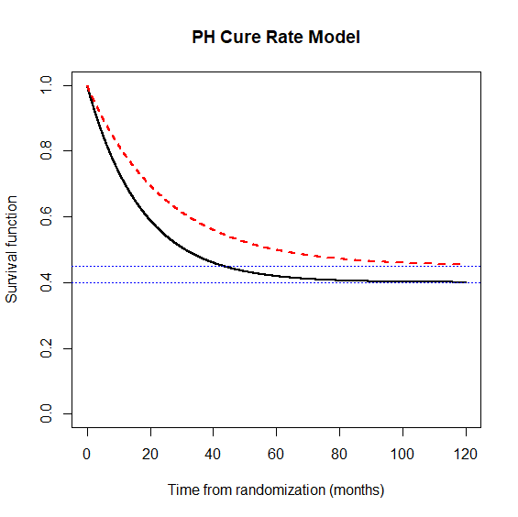
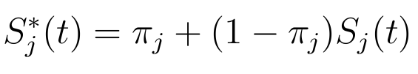

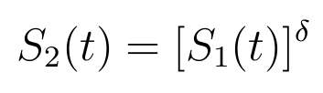
Proportional Hazards Cure Rate Model
PHCRM
PHCRM
Notes:
With long-term survivors, an appropriate survival distribution function is a mixture cure model.
The treatment effect is characterized by the hazard ratio of uncured patients and
cure rate of long-term survivors. Such model is called PHCR model.

Slide 14
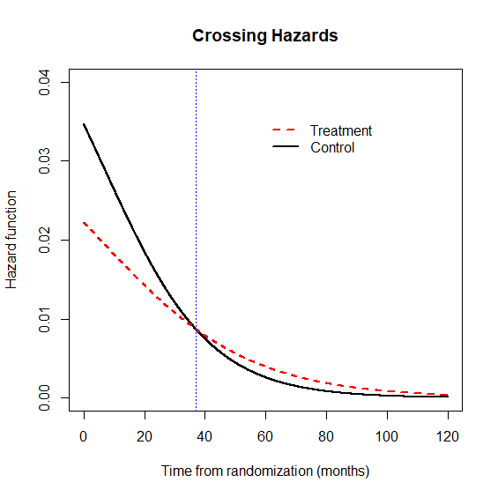
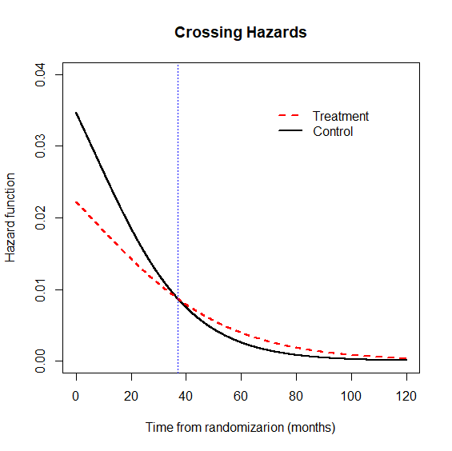
Proportional Hazards Cure Rate Model
Notes:
To reach the cure, the hazard functions are crossing over. With crossing over hazards model, the standard log rank test is inefficient.

Slide 15
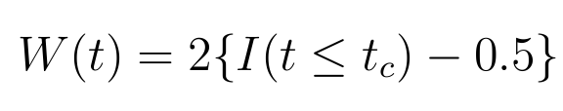

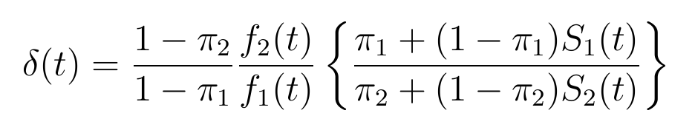
Change Sign Weighted LRT
For crossing hazards, a change sign weighted log-rank test is more efficient, with weight function
Optimal weighted log-rank test with ,, where
Notes:
The standard log-rank test is a weighted sum difference of hazard rates at each failure time point.

Slide 16
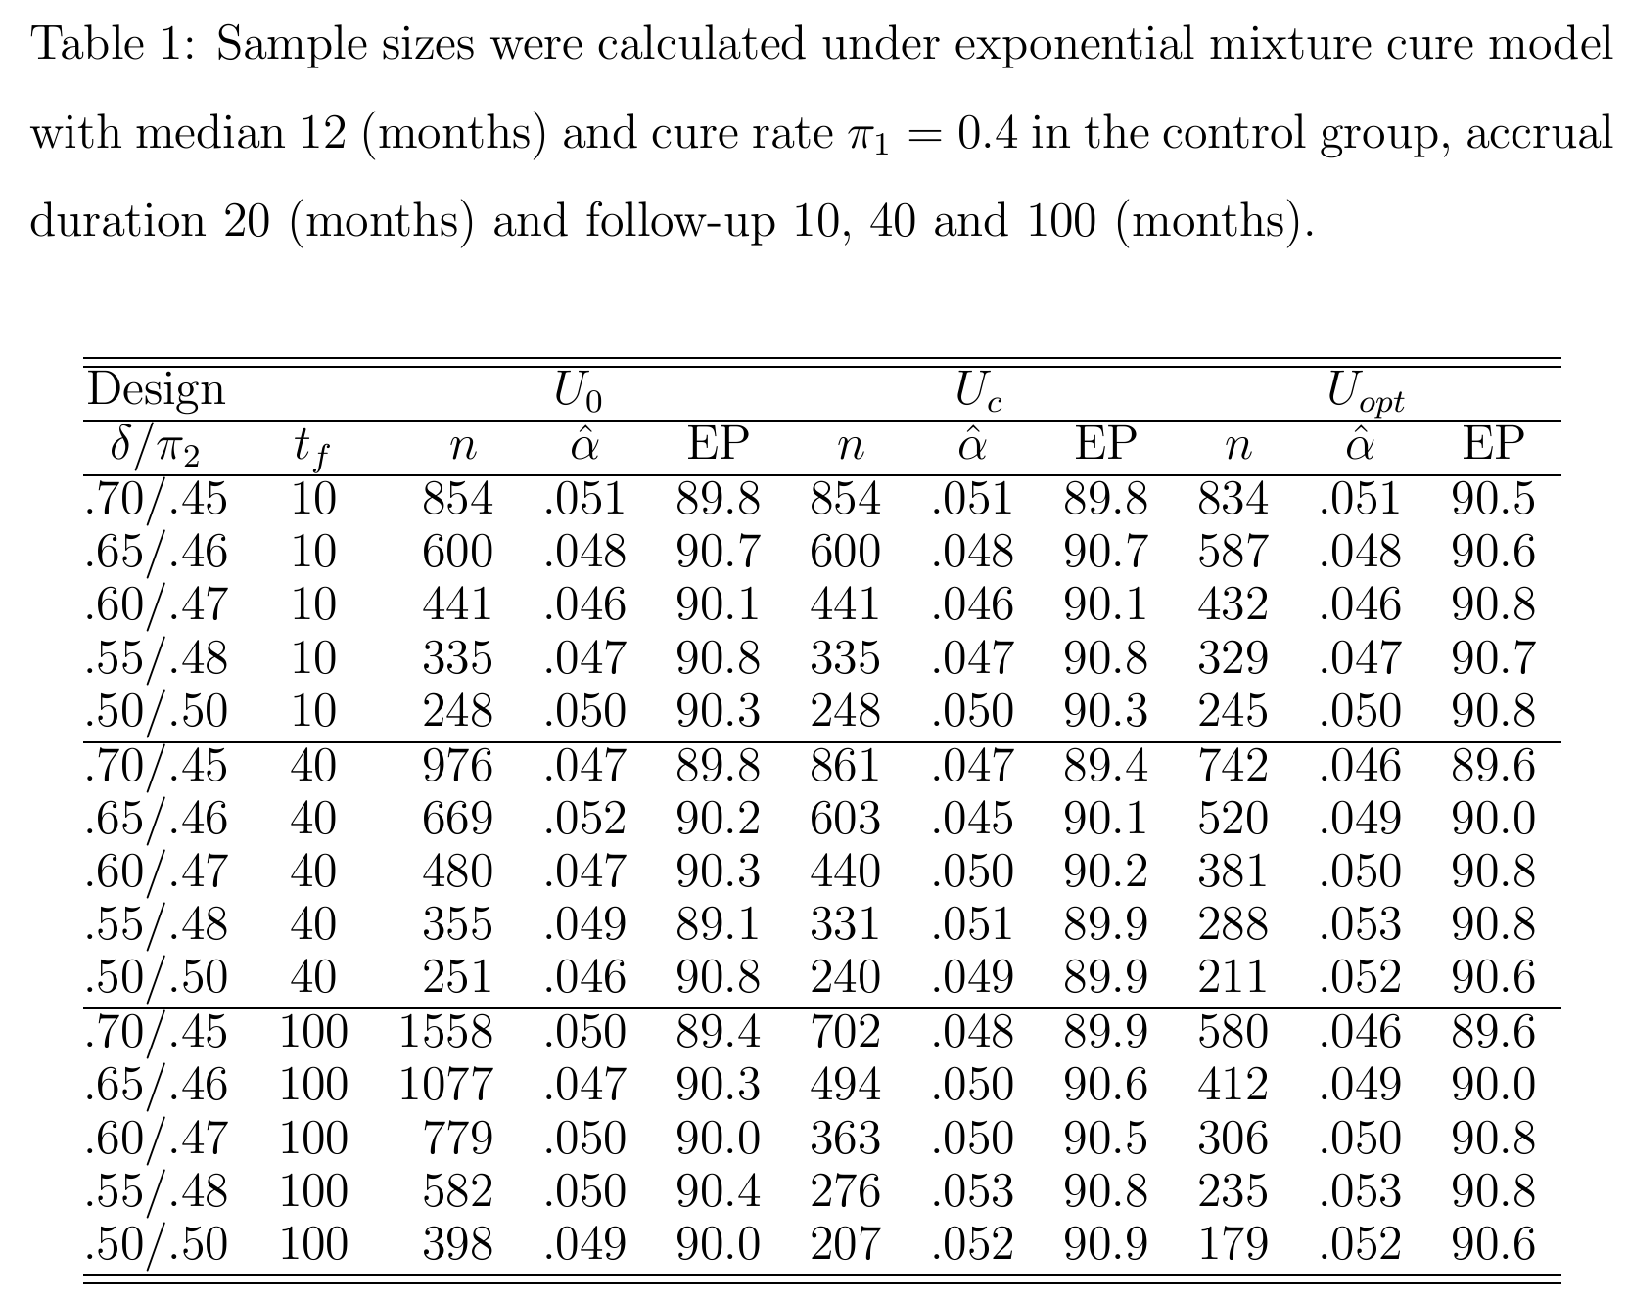
Simulation
Short term
Follow-up
Notes:
For a short-term follow-up (before or just over the hazard crossing time point), the standard log-rank test us as efficient as
The sign weighted log-rank test and optimal weighted log-rank test but it loss efficient for a long-term follow-up.
While the sign weighted log-rank test does not loss much efficiency compared to the optimal weighted log-rank test.

Slide 17
Simulation
Long term
Follow-up
Notes:
For a short-term follow-up (before or just over the hazard crossing time point), the standard log-rank test us as efficient as the sign weighted log-rank test and optimal weighted log-rank test but it loss efficient for a long-term follow-up.
While the sign weighted log-rank test does not loss much efficiency compared to the optimal weighted log-rank test.

Slide 18
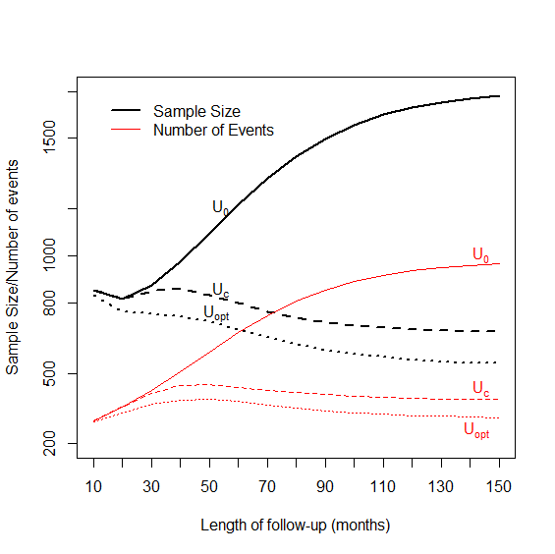
Sample Size vs Length of Follow-up
Notes:
As follow-up increases, the sample size decreases before crossing over, then start increasing for U0, for Uc but decreases again, always decrease for Uopt after crossing over.

Slide 19
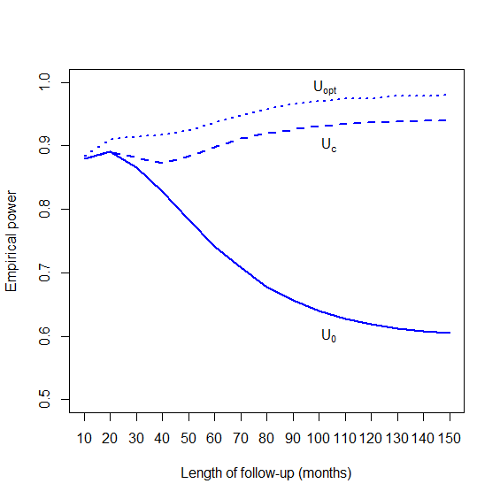
Empirical Power vs Length of Follow-up
Notes:
Empirical power vs. follow-up

Slide 20
Case Study: Melanoma Trial
Robert et al NEJM 2011; Maio et al JCO 2015
Notes:
After you saw the KM curves, do you still feel it is right or comfortable for the original design?

Slide 21
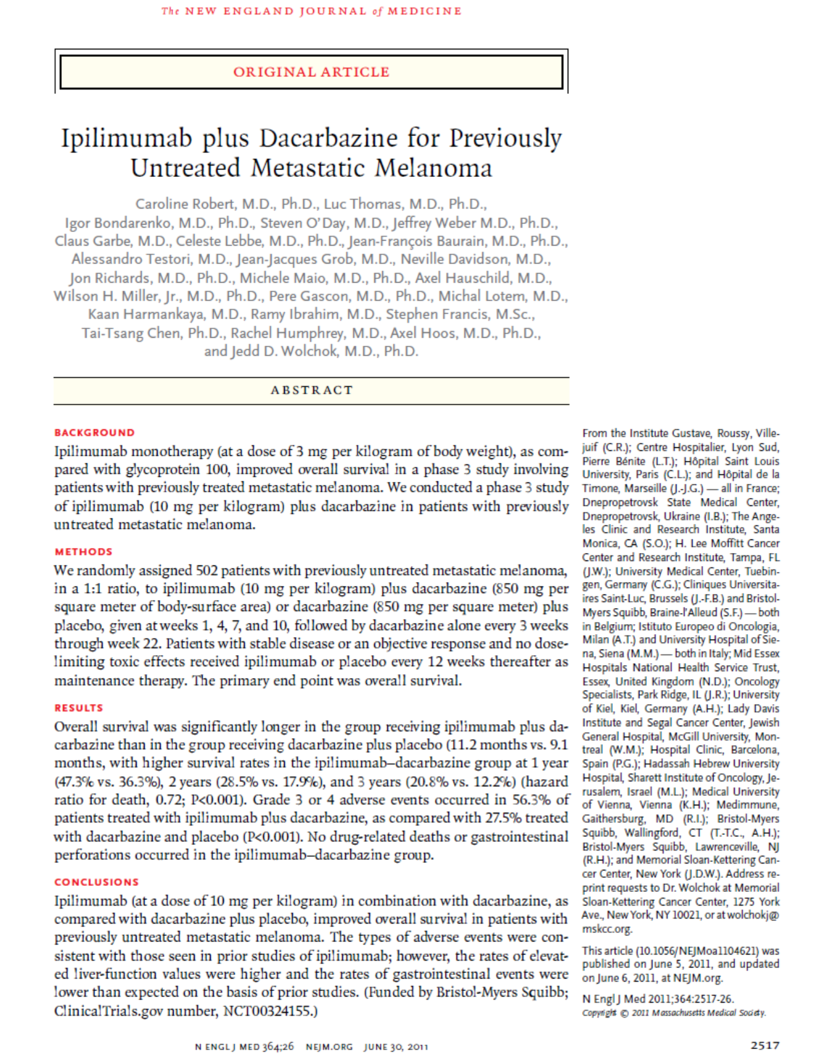
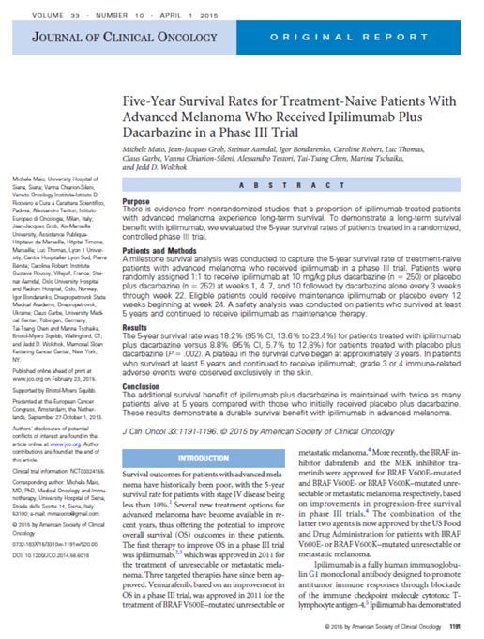


Slide 22
Case Study: Melanoma Trial
Study design: Assuming overall survival follows exponential distribution with median survival of 8 months for dacarbazine plus placebo. With two-sided type I error of 5%, 17 months accrual and follow-up, a total of 500 patients (1:1 allocation ratio) and 414 deaths are needed to provide 90% power to increase in median survival to 11 months for dacarbazine plus ipilimumab using log-rank test.

Slide 23
Issues of Design and Analysis
Sample size was calculated under exponential PH model using Schoenfeld formula. The analysis was performed after 414 deaths occurred (502 patients) and 37 months follow-up after the last patient was enrolled (event-driven approach).
Median OS was significantly longer in patients receiving ipilimumab + dacarbazine than in patients receiving placebo + dacarbazine: median OS 11.2 vs. 9.1 months, hazard ratio 0.72; P<0.001 (NEJM, 2011). Is appropriate to estimate HR using Cox model? Is p-value calculated from Cox model?
5-year OS rate was 18.2% vs. 8.8% (P=0.002) (JCO, 2015). (post ad hoc analysis! P-value from long rank test? 1-year, 2-year, 3-year, 4-year OS rates are also reported.)
Notes:
Using the wrong information to make the conclusion.

Slide 24

Case Study: Design under PHCRM
There is evidence from nonrandomized studies that a proportion of ipilimumab-treated patients with advanced melanoma experience long-term survival (JCO, 2015).
Consider the Weibull PHCRM:
Assuming, the median OS of control is 9.1 (months) for uncured patients and cure rate is 12% for control group, the trial is designed to detect a hazard ratio 0.72 for uncured patients and increase cure rate to 18%. Uniform accrual with accrual period of 17 months and follow-up 37 months, then, a total of 405 patients (340 deaths) are needed for this randomized trial (1:1 allocation ratio) with 90% power and two-sided type I error rate of 5% by using the change sign weighted log-rank test.
The New Model and New Design saves 100 patients !
Notes:
In 2015 JCO paper, authors mentioned that “There is ….”. Therefore, the PHCRM is appropriate to be used for the trial design.

Slide 25
Conclusion
Immunotherapy trial with long-term survivors could result in crossing over of hazards.
Traditional event-driven trial design is no longer applied.
Treatment effect can be quantified by hazard ratio and cure rate.
To detect long-term survival improvement, a change sign weighed log-rank test is more efficient.
Long-term follow-up is necessary to confirm the long-term survival.

Slide 26
Reference
Sun S, Liu G, Lyu T, Xue F, Yeh F, Rao S. Design consideration in clinical trials with cure rate survival data: A case study in oncology. Pharmaceutical Statistics, 2018; 17:94-104.
Wu J. Sample size calculation for testing differences between cure rates with the optimal log-rank test. Journal of Biopharmaceutical Statistics, 2017 27:124-134.
Wang S, Zhang J, Lu W. Sample size calculation for the proportional hazards cure model. Statistics in Medicine, 2012; 31:3959-3971.
Ding X, Wu J. Cancer immunotherapy trial design with long-term survivors, Pharmaceutical Statistics, 2019 (submit)

Slide 27
Thank You

